Slide 1

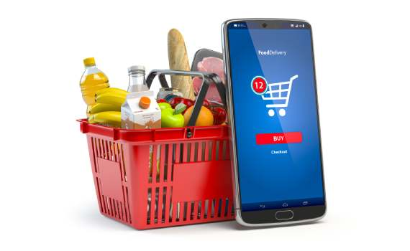
GROCERY STORE MANAGEMENT
USING SQL
Presentation by
B .Prathyusha
T .Sai Subham
T. Harish Reddy

Slide 2
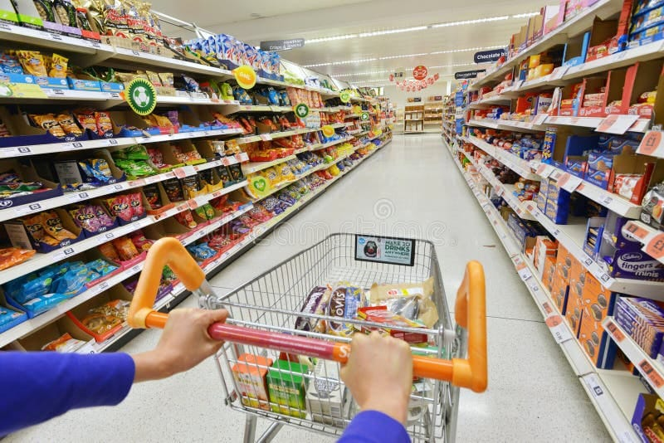
.
GROCERY STORE MANAGEMENT

Slide 3
Agenda
Introduction
Objective of the Project
ER Diagram and schema explanation
Problem statement
SQL query results and their description
Final business insights
Recommendations
Conclusion

Slide 4
INTRODUCTION
From beginning with barter system to reaching to a seamless transactions, walking thousand miles to buy groceries to getting in front of the door, managing the shops and stocks with humans in the store to operating it from online systems, making goods by man made to making it from machine made, the retail and grocery management systems journey was commendable.
But due to ineffective management of inventory, suppliers, customer orders, employees, and product categories, it leads to loss for grocery stores as well as customers.
So, efficient data handling helps businesses track sales and revenue, monitor product availability, employee details, and also analyse operations.

Slide 5
Objectives
This project is related to a mini grocery store database with interconnected entities such as orders, products, employees, and suppliers.
It offers hands-on experience in understanding data relationships and operational workflows.
By using Mysql, we can extract and transform data then it will be useful for data driven – decision making for gaining valuable business insights and operational efficiency through data analysis.

Slide 6
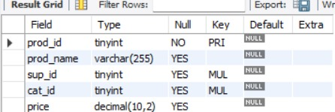
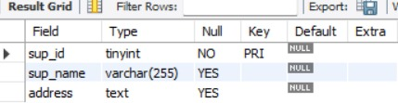
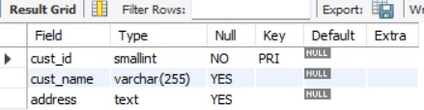

Tables
Product table Suppliers table
Customers table
Categories table

Slide 7
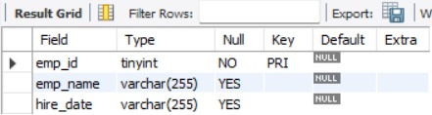
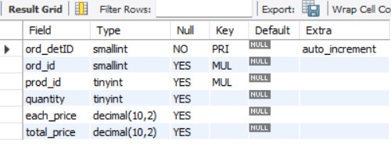
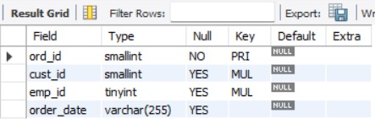
Tables
Employees table Order_details table
Orders table

Slide 8
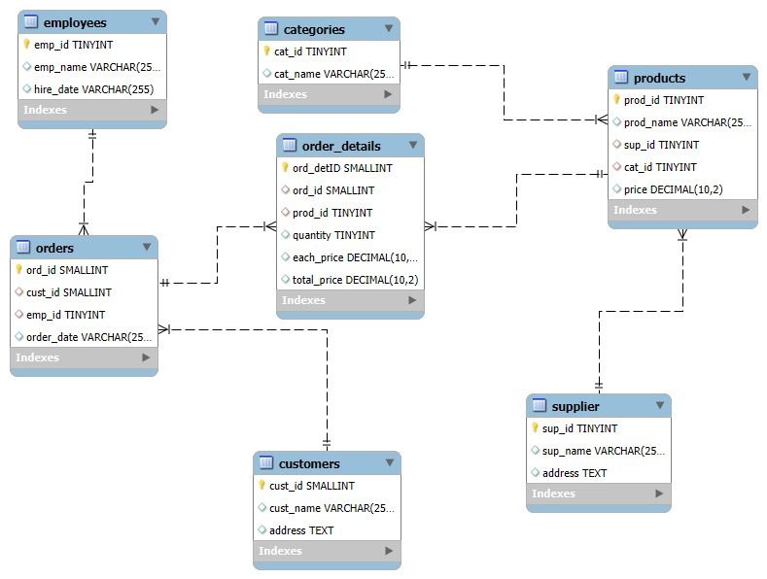
ER DIAGRAM

Slide 9
ER DIAGRAM DESCRIPRTION
Core Entities: The database includes seven main tables: employees, customers, orders, order_details, products, categories, and supplier, each representing a key business component.
Relational Structure: Tables are connected through foreign keys—e.g., orders links customers and employees, while products connects to both categories and supplier.
Order Flow Logic: The orders table captures transactions, and order_details breaks down each order into individual product quantities and pricing.
Product Classification: Products are categorized via cat_id and sourced from suppliers via sup_id, enabling organized inventory and supplier tracking.
Data Types & Design: Fields use appropriate types like TINYINT, SMALLINT, DECIMAL, and VARCHAR, balancing storage efficiency with clarity for business analysis.

Slide 10
Problem statement
In a grocery store, there’s a lot of information about products, suppliers, customers, and orders. Managing and understanding all this data is important to run the store well and make smart decisions. This project is about creating a database that stores all this information and by SQL we are retriving and analysing the data to find useful insights — like which products sell the most, who the best customers are, and how much money is being made. The system will support complex queries to identify key business insights such as top-performing products, high-value customers, and revenue patterns, while reinforcing practical SQL skills including joins, aggregations, subqueries, and filtering.

Slide 11
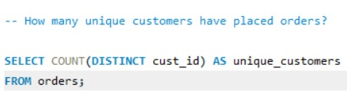

1.How many unique customers have placed orders?
-
Description:-
The query counts the distinct cust_id values from the orders table to find the number of unique customers . The result shows that 156
unique customers have placed orders.
Output

Slide 12
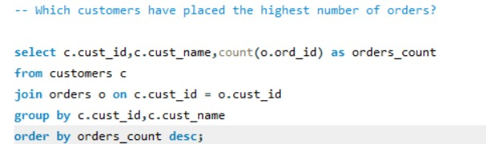
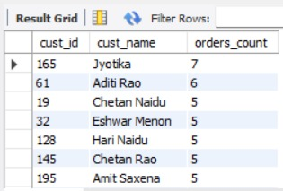
2.Which customers have placed the highest number of orders?
Description:-
.
This query finds which customers ordered the most.
Result:
Jyotika ordered the most (7 orders).Aditi Rao, Chetan Naidu, Eshwar Menon, Hari Naidu, Chetan Rao, and Amit Saxena each made 5 orders.
Output

Slide 13
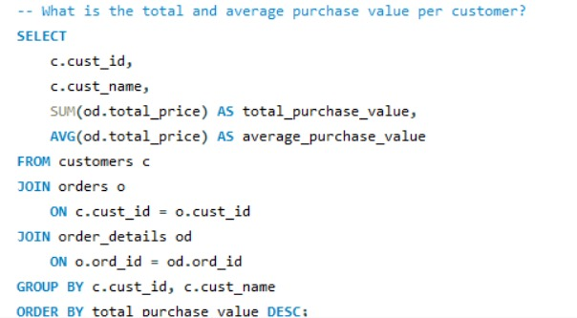
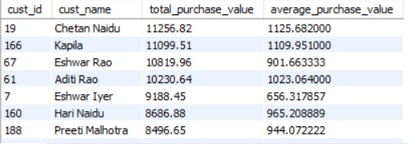
3.What is the total and average purchase value per customer?
-
This query shows the total and average purchase value for each customer, arranged
from highest total to lowest.Result in simple words:Chetan Naidu spent the most
overall — ₹12,569.50 total, with an average of ₹2,094.92 per order.
Other top spenders
include Chetan Rao, Jyotska, and Aditi Rao, each with totals above ₹10,000.
Output

Slide 14
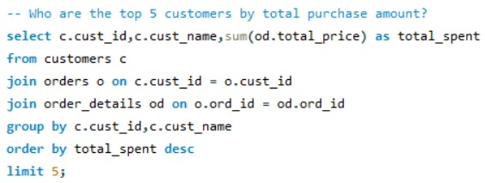
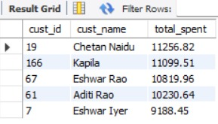
4.Who are the top 5 customers by total purchase amount?
Description:-
This query finds the top 5 customers by total purchase amount.
Here’s the result from the output table:
Top 5 Customers by Total Spent1. Chetan Naidu – 11,256.822
Eshwar Rao – 10,299.963. Aditya Rao – 10,219.544. Adith Rao – 9,882.065. Eshwar Iyer – 9,188.45
Output

Slide 15
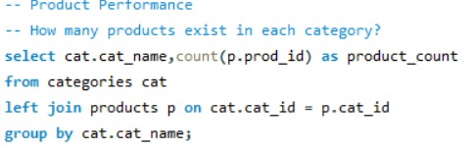
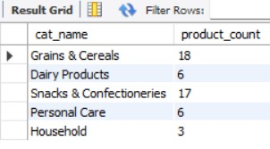
5.How many products exists in each category?
This query finds the number of products in each category : Dairy Products – 18 Grains/Cereals – 17 Snacks & Confectioneries – 6 Personal Care – 6 Household – 3
Insight : Dairy Products have the highest variety, while Household items have the least.
.
Output

Slide 16
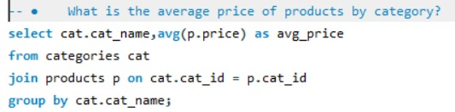
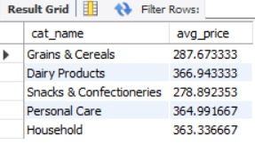
6.What is the average price of products by category?
.
This query finds out Average Price of Products by Category:Grains & Cereals: ₹287.67Dairy Products: ₹286.49Snacks & Confectioneries: ₹278.99Personal Care: ₹304.99Household: ₹305.33
InsightS: Household products have the highest average price, while Snacks & Confectioneries have the lowest.
Output

Slide 17
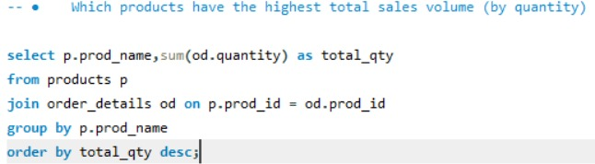
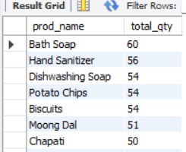
7.Which products have the highest total sales volume(by quantity)?
.
This query finds products with the highest total sales volume (by quantity) are:1. Bath Soaps – 606 units2. Hand Sanitizer – 55 units3. Liquid Sanitizer – 54 units4. Bathing Soap – 54 units5. Potato Chips – 54 units6. Masoor Dal – 51 units7. Chopped Dal – 50 units
Output

Slide 18
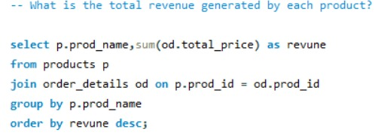
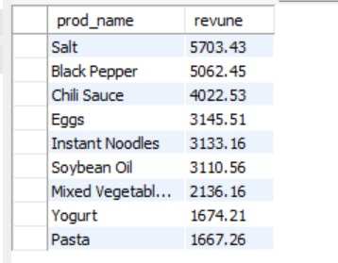
8.What is total revenue generated by each product?
.
total revenue generated by each product. The question asks for the total revenue generated by each product . Total Revenue Generated by Each Product:
Salt: 5703.43
Black Pepper: 5062.45
Chili Sauce: 4022.53
Eggs: 3145.51
Instant Noodles: 3133.16
Soybean Oil: 3110.56
Mixed Vegetables: 2136.16Yogurt: 1674.21Pasta: 1667.26
Output

Slide 19
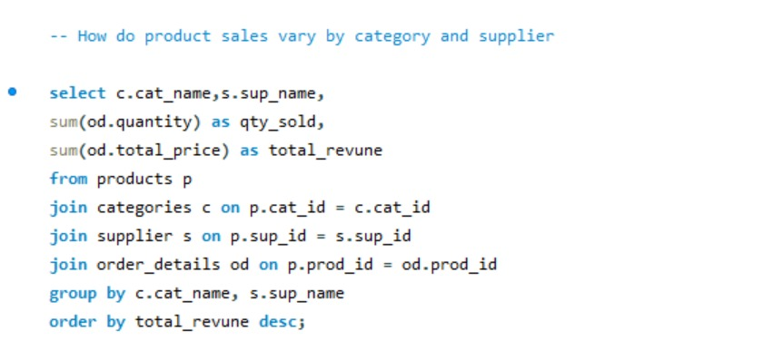
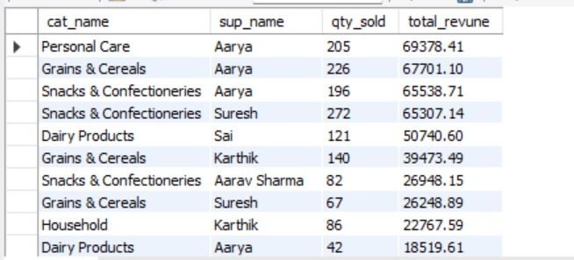
9.How do product sales vary by category and supplier?
The provided SQL query calculates the total quantity sold and total revenue for each product category, grouped by category name and supplier name, and ordered by total revenue in descending order.
Perosnal care and grains & cereals are the top
.

Slide 20
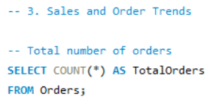

10.How many orders have been placed in total?
This query is used to count the total number of records (orders) in the 'Orders' table. The result of this query is 300 orders have been placed in total.
Output

Slide 21
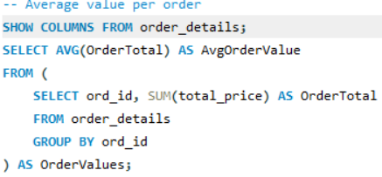

11.What is average value per order?
This query finds the average value per order is calculated by first finding the sum of total_price for each order (OrderTotal) and then calculating the average of these OrderTotal values.
The average value per order is 2153.632539
Output

Slide 22
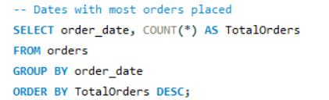
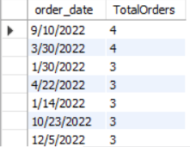
12.On which dates were the most orders placed?
Query finds out count the number of orders for each
order _ date and then sort the results in descending order of Total Orders. This means the dates with the highest number of orders will appear at the top of the result set.
9/10/2022has Total Orders of 4.3/30/2022also has Total Orders of 4.
Output

Slide 23
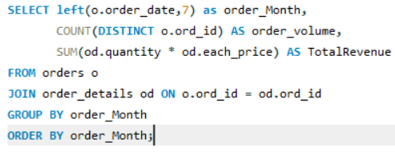
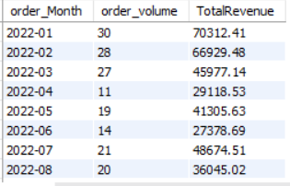
13.What are the monthly trends in order volume and revenue?
The image displays a SQL query designed to analyze monthly trends in order volume and revenue, along with a partial result set.
Total Orders as 256, and Total Revenue as 551329.52.
Output

Slide 24
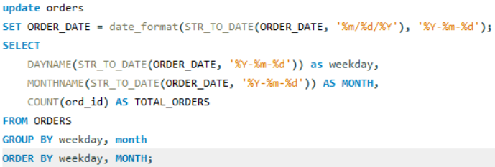
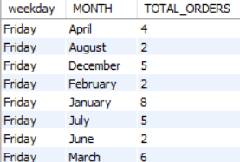
14.How do order patterns vary across weekdays and months?
This query Analyzes how order patterns vary across weekdays
and months based on the provided data.
Weekday has 300 orders
Output

Slide 25
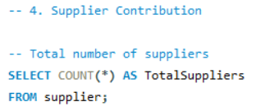

15.How many suppliers are there in the database?
Query finds how many suppliers are there in the database.
So, There are 5 suppliers in the database.
Output

Slide 26
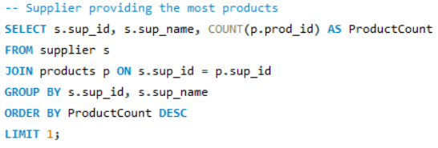

16.Which supplier provides the most products?
Identify the supplier providing the most products. The query joins the supplier and products tables, groups the results by sup_id and sup_name, counts the products for each supplier, orders them in descending order of ProductCount, and then limits the result to the top one.
Sup_id:3
sup_name:Aarya
ProductCount 18
Output

Slide 27
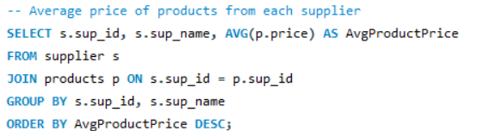
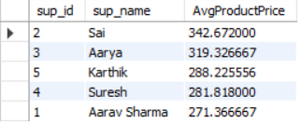
17.What is the average price of products from each supplier?
which calculates the average price of products for each supplier.
Sai342.6720003
Aarya319.3266675
Karthik288.225556
Output

Slide 28
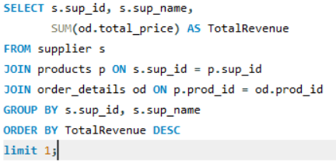

18.Which suppliers contribute the most to total product sales(by revenue)?
Query provided already orders the suppliers by Total Revenue in descending order, meaning the supplier with the highest revenue is listed first.
supplier who contributes the most to total product sales by revenue is Aarya (sup_id: 3), with a Total Revenue of 221137.83
Output

Slide 29
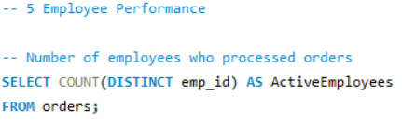

19.How many employees have processed orders?
This query counts the number of unique employee IDs (emp_id) from the orders table, effectively counting the number of distinct employees who have processed at least one order.
10 employees have processed orders.
Output

Slide 30
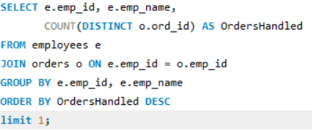

20.Which employees have handled the most orders?
The query asks to identify the employees who have handled the most orders. The provided SQL query and the resulting table show the employees ordered by the number of orders they handled in descending order.Solution:
Diya Sharma 1 (38 orders)
Aditya Singh 1 (37 orders)
Arjun Kumar 1 (32 orders)
Pari Kumar 1 and Pari Sharma 1 (both with 31 orders)
Output

Slide 31
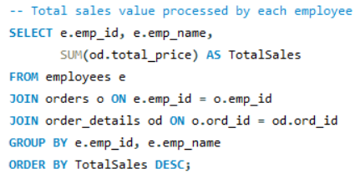
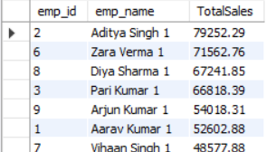
21 .What is the total sales value processed by each employee?
total sales value processed by each employee.Total sales value processed by each employee:
Aditya Singh:79252.292.
Zara Verma:71562.763.
Diya Sharma:67241.854. Pari Kumar:
Output

Slide 32
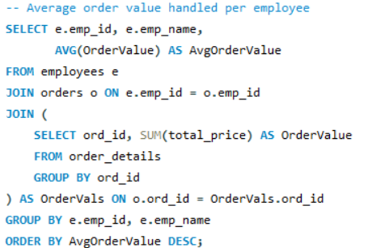
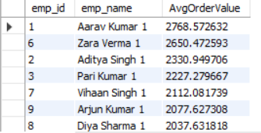
22.What is the average order value handled per employee?
Average order value handled per employee.
average order value for several employees . Aarav Kumar: 2768.572632 Zara Verma: 2650.472593 Aditya Singh: 2330.949706 Pari Kumar: 2227.279667 Vihaan Singh: 2112.081739 Arjun Kumar: 2077.627308 Diya Sharma: 2037.631818
Output

Slide 33
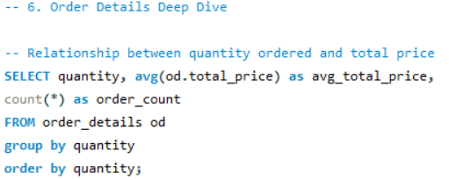
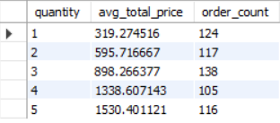
23.What is the relationship between quantity ordered and total price?
query and its corresponding results, demonstrating the relationship between the quantity ordered and the average total price of orders. Relationship between Quantity Ordered and Total Price: The data shows a clear positive relationship between the quantity ordered and the average total price. As the quantity increases, the avg_total_price also tends to increase. Quantity 1:Average total price is 319.274516Quantity 2:Average total price is 595.716667Quantity 3:Average total price is 898.266377
Output

Slide 34
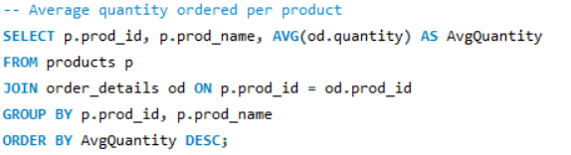
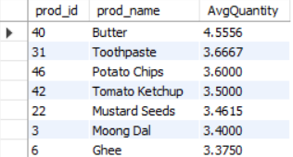
24.What is the average quantity ordered per product?
Query ,which calculates the average quantity ordered per product Butter:4.5556Toothpaste:3.6667Potato Chips:3.6000Tomato Ketchup:3.5000
Output

Slide 35
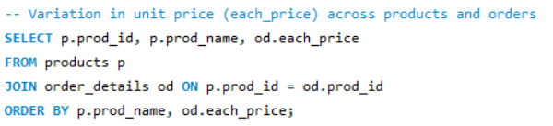

25.How does the unit price vary across prodcuts and orders?
The SQL query shown is designed to fetch the prod_id, prod_name from the products table, and the each_price (unit price) from the order_details table.
Output

Slide 36

INSIGHTS
Customer insights
Product performance
Sales and revenue trends
Supplier analysis
Operational efficiency

Slide 37
Recommendations
Enhance Customer Loyality :
Launch loyalty programs for top customers . Offer personalized discounts based on buying history.
Boost Product Sales:
Increase stock and promotion for best-selling items . Introduce bundle offers for slow-moving products.
Optimize Inventory Management:
Maintain safety stock for high-demand products . Reduce overstock of low-performing items.
Improve Supplier Relationships:
Prioritize reliable suppliers with consistent delivery . Negotiate better terms with high-performing suppliers.
Data-Driven Decision Making:
Continue using SQL reports for weekly/monthly insights . Integrate sales trends into marketing and stocking strategies.

Slide 38
SUMMARY
The Grocery Store Management System organizes and analyzes store data using SQL, enabling quick and accurate reporting . It provides actionable insights to boost sales, manage inventory efficiently, and improve overall business decisions.

Slide 39


Slide 40

THANK YOU

